Slide 1

CLASS : 2
SAS Tutorial
Presented By : Shashi Kumar

Slide 2
Topic: SAS Variable
Numeric | Character
It can hold 0-9,integer number, decimal number | It can hold any character values, such as letter or number, special character and “ “ (blank)
Right align | Left align
Missing Value/Blank assign as . (dot) | Missing Value/Blank assign as “ “ (Space)
Default length is 8 bytes | Default length is 8 bytes
16-17 digit number when 8 bytes | 8 bytes hold 8 character
Minimum length is 3 bytes | Minimum length is 1 bytes
Maximum length is infinite (depend on RAM Size) | Maximum length is 32767

Slide 3

Topic: SAS Naming Convention for Variable and Data set
Name can hold maximum 32 character.
Name should begin with _ (under score) or letter and seconds onwards letter can be _ (under score),letter or numeric.
Special Character not permitted except _ (under score).
SAS name is case insensitive ,it may be upper, lower or prop case.
test
test123
_test
@test
4test
Test&
TEST
_12test

Slide 4
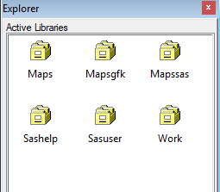




Library :
SAS library is simply a collection of SAS files that are stored in the same folder or directory on your computer. Other files can be stored in the same folder or directory, but only the files that have SAS file extensions are recognized as part of the SAS library.
Depending upon on your need SAS library is of two types :
Work as Temp
Sashelp or lib ref are permanent
All content deleted after SAS session
Content retained even after SAS session
Dataset
View
Catalog
SAS pgm file

Slide 5
Library : Temporary to permanent
Syntax:
Libname <libref> <engine> path;
i.e. Libname sk “D:\Users\703215742\Desktop\SAS CLASS”;
This LIBNAME statement specifies sk as a reference to a SAS library. The EXCEL engine specifies the engine that supports the connection to the file type .XLSX.
Libname sk EXCEL “D:\Users\703215742\Desktop\SAS CLASS\file.xlsx”;
Libname sk “D:\Users\703215742\Desktop\SAS CLASS\file.xlsx”;
Access Tera Data in SAS:
libname sk teradata user="userid" password="password" mode=teradata server="servername“ connection=global dbmstemp=yes;
<libref> : - Naming Convention
Name can hold maximum 8 character.
Name should begin with _ (under score) or letter and seconds onwards letter can be _ (under score),letter or numeric.
Special Character not permitted except _ (under score).
SAS name is case insensitive ,it may be upper, lower or prop case.

Slide 6
Library : Temporary to Permanent
Temporary to Permanent Library
Data one;
Set sashelp.class;
Run;
Libname sk “D:\Users\7032xxxxx\Desktop\SAS CLASS”;
Data sk.two;
Set sashelp.class;
Run;
Dataset one is stored in temporary library “Work”.
(All content deleted after SAS session)
Dataset two is stored in Permanent library “sk”.
(Content retained even after SAS session)

Slide 7
Proc Print :-
Syntex:-
proc print data =input data <option>;
Var var1 var2…varn;
Id var1 var2 …varn;
run;
Var : It define the variables and observation in o/p window.
Id: It suppress the observation column and id variable comes the first variable in o/p window.
Options:-
Noobs:- It suppress the observation column in the proc print o/p.
Double:- It provides space between the observation.
Obs=n:- It give the first n observation from the dataset.
Examples:-
proc print data =sashelp.class;run;
proc print data =sashelp.class; var age sex;run;
proc print data =sashelp.class; id age;run;
proc print data =sashelp.class double ;run;
proc print data =sashelp.class (obs=10);run;

Slide 8
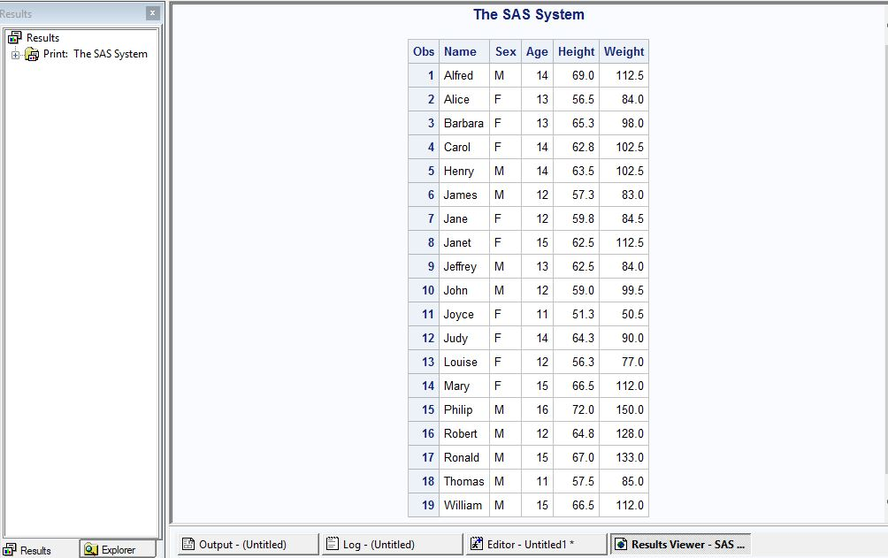
Proc Print :-
proc print data =sashelp.class;run;

Slide 9
Proc Contents:-
Syntax:-
proc contents data=input data <option>;run;
It display description portion of dataset by default by show the result in three parts.
Attributes
Engine/Host
List of Variables
Examples:-
proc contents data=sashelp.class; run;
proc contents data=sashelp.class varnum; run;
proc contents data=sashelp._all_; run;
proc contents data=sashelp.class nods; run;

Slide 10
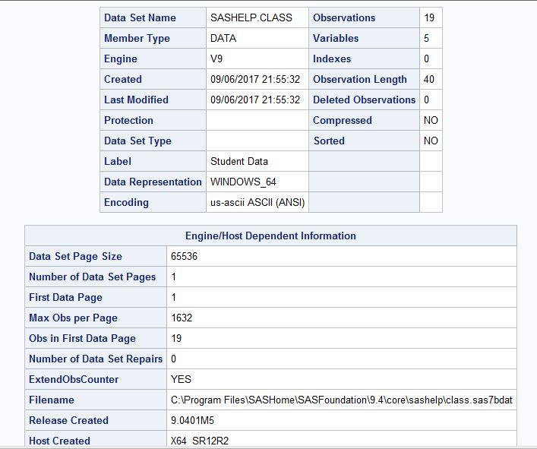
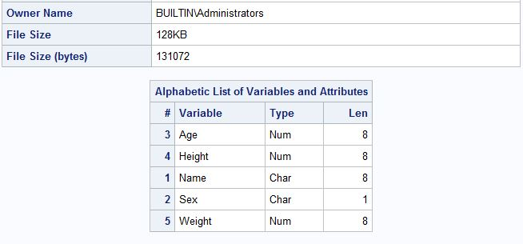
Proc Contents:-

Slide 11
Exercise:-
1. Create Permanent Library
Libname sk “D:\Users\7032xxxxx\Desktop\SAS CLASS”;
Data sk.two;
Set sashelp.class;
Run;
Data one;
Set sashelp.class;
Run;
2. proc print data =sashelp.class;run;
3. proc contents data=sashelp.class; run;

Slide 12
Thank You …

